Slide 1

BIM 6TH SEMESTER — IT PROJECT PROPOSAL DEFENCE
Smart Queue Management System
TOKEN
for Government Offices in Nepal
A - 042
NOW SERVING
STUDENT
Siddhartha Shakya
ROLL NUMBER
16055/23
PROGRAMME
BIM — 6th Semester
COLLEGE
NCCS
SUPERVISOR
Teksan Gharti Magar
1

Slide 2



Introduction
Government offices provide essential services
SERVICE DELIVERY FLOW
Services attract many daily visitors
Citizen
Queue management affects service efficiency
Government Office
Citizens often experience physical queues
Waiting information is often limited
Queue
Digital solutions can improve queue management
Service Counter
2

Slide 3
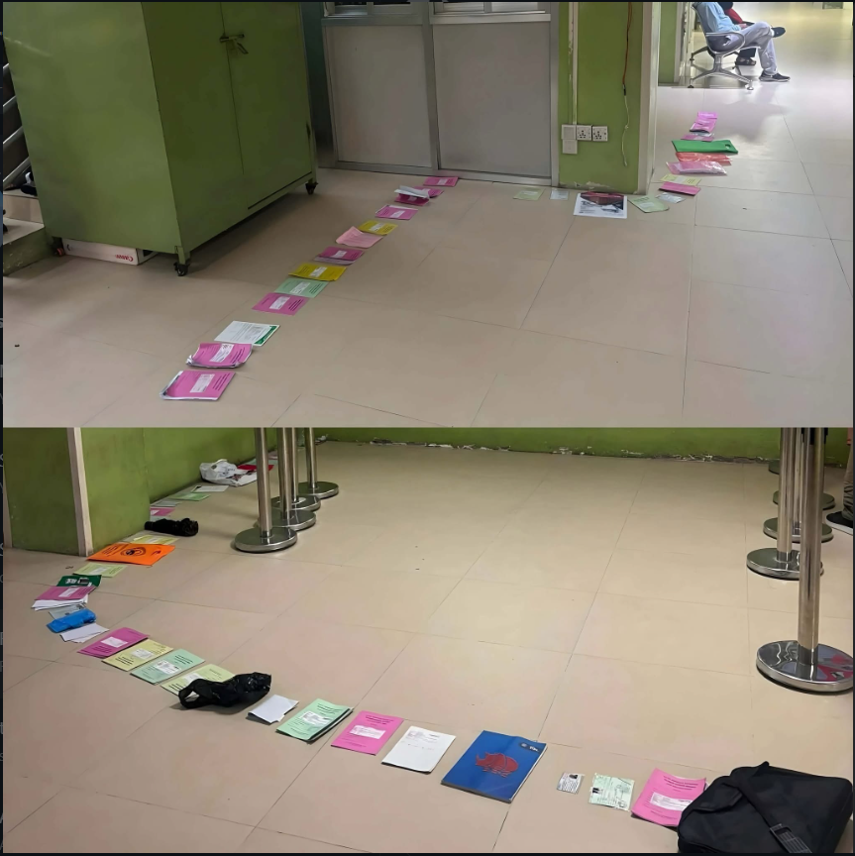
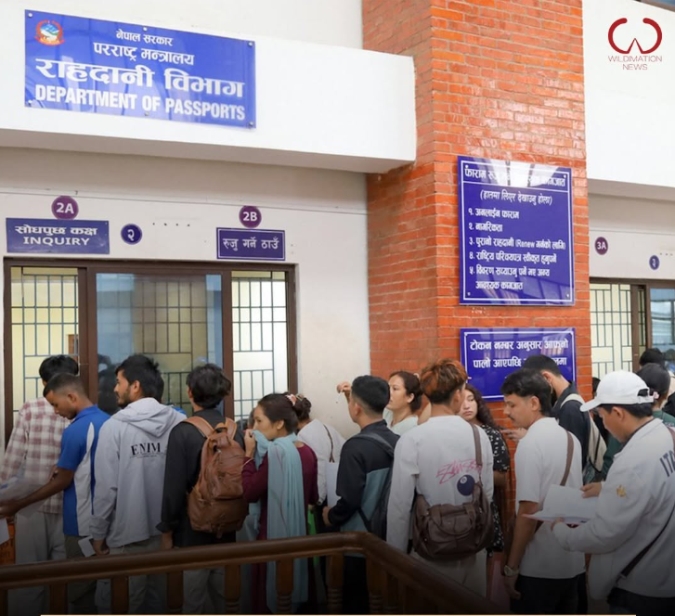
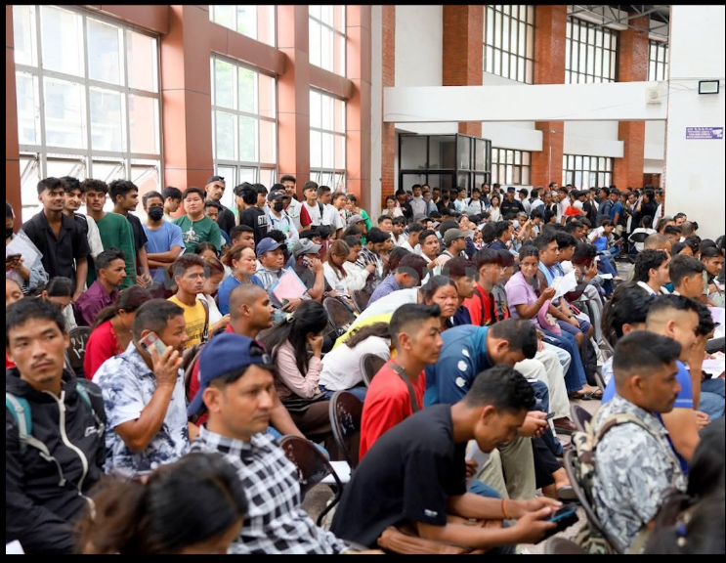
Problem Statement
3

Slide 4

Problem Statement
“Citizens face uncertain waiting periods.”
Uncertain expected waiting time
Dependence on physical queues
Queue progress not visible to citizen
Limited queue progress visibility
Overcrowded waiting locations
4

Slide 5



Objectives
PRIMARY OBJECTIVE
Digital Queue Management
To develop a digital system for efficient government queue management.
Better Queue Visibility
Secondary objective: To improve transparency in queue operations.
More Efficient Waiting
5

Slide 6





Proposed Solution
Smart Queue Management System
Same-day digital queue tokens
Real-time queue status
Estimated waiting time
Multiple service counters
QR and manual check-in
Digital queue administration
Progressive Web Application
Select
Service
Get
Token
Check-in
Join
Queue
Monitor
Service
6

Slide 7
Major Features
Digital token generation
Queue tracking
Waiting-time estimation
Priority queue management
Queue audit logging
Queue history
7

Slide 8

Expected Outcome
Less physical waiting
Better queue visibility
More organized service delivery
Less Overcrowded Waiting Place
8

